Slide 1
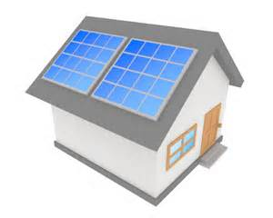
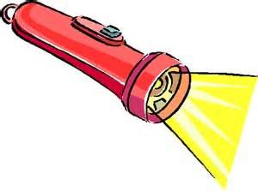
Electrical
Heat and Light
Chemical
Motion
Light
Electricity
Chemical
Light

Slide 2
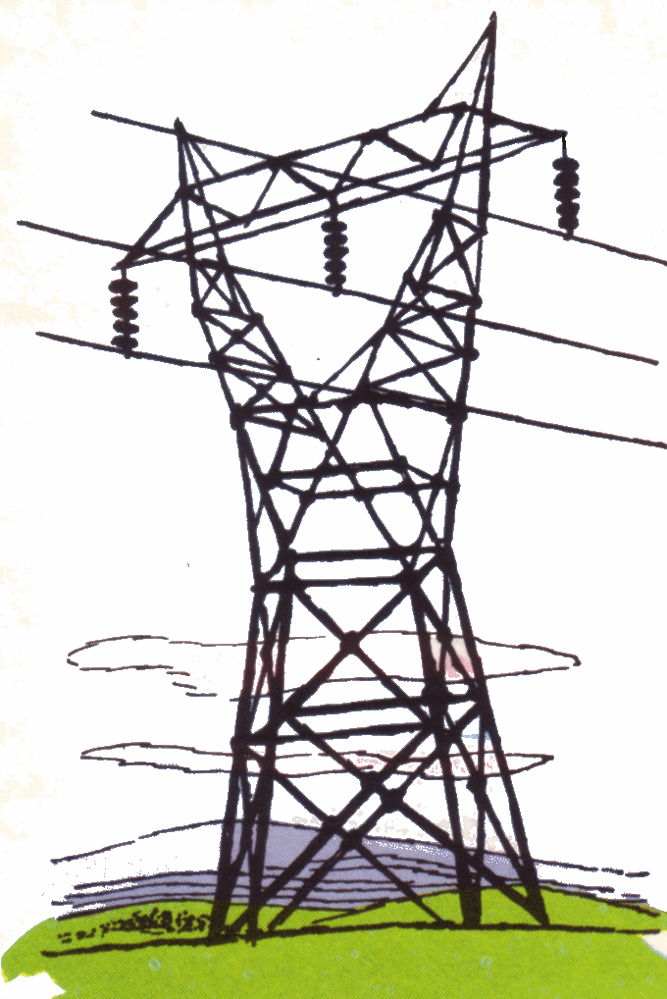
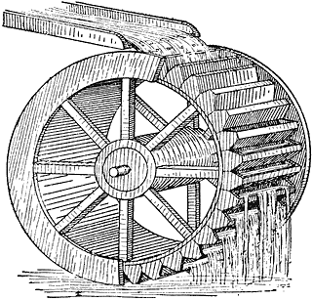
Light
Chemical
Motion
Electrical
Chemical
Light + Heat
Motion
Sound

