Slide 1
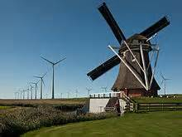
Windmills

Slide 2
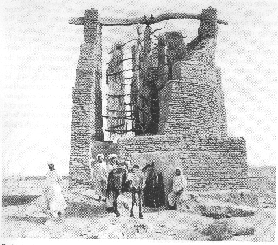
What is a windmill?
Windmills convert energy from the wind into rotational energy by means of blades.
Centuries ago, windmills usually were used to mill grain, pump water, or both. Thus they often were gristmills, windpumps, or both. The majority of modern windmills take the form of wind turbines used to generate electricity, or windpumps used to pump water, either for land drainage or to extract groundwater.
Early “Windmill” in Afghanistan (900AD)

Slide 3
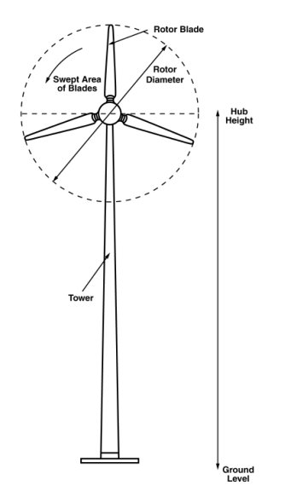
VOCABULARY
Blade pitch – The angle of the blades with respect to the plane of rotation. (Blades perpendicular to the oncoming wind would be 0 degrees. Blades parallel to the wind would be 90 degrees.)
Driveshaft – The rod or shaft connected to the hub; it rotates with the rotor. energy transformation – The conversion of energy from one form to another. For example, when coal (chemical energy) is burned, it produces heat (thermal energy) that is then captured and used to turn a generator (mechanical energy), which transforms the energy into electricity (electrical energy).
Hub – Central component connecting the blades to the driveshaft.
Plane of rotation – The area directly in line with the rotor. This is a dangerous area to stand in case a blade flies out while the windmill is spinning.
Rotor – The rotating section comprised of blades projecting from a hub.

Slide 4
VOCABULARY
Drag – In a wind turbine, this is also called wind resistance. The friction of the blades against air molecules as they rotate. Drag works against the rotation of the blades, causing them to slow down.
Force – A push or pull. friction – A force that resists the relative motion of two bodies in contact.
Torque – A force times a distance that causes rotation. In a windmill, each blade acts like a lever arm rotating around an axis. The more surface area the blade has, the more torque the wind applies to the blade.

Slide 5
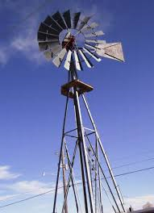
How does a windmill work?
The terms wind energy or wind power describe the process by which the wind is used to generate mechanical power or electricity. Wind turbines convert the kinetic energy in the wind into mechanical power. This mechanical power can be used for specific tasks (such as grinding grain or pumping water) or a generator can convert this mechanical power into electricity.
The wind turns the blades, which spin a shaft, which connects to a generator and makes electricity.
https://www.youtube.com/watch?v=BugXmDxC0WM

Slide 6
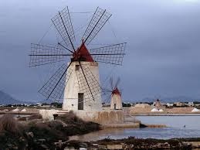
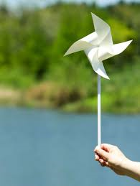
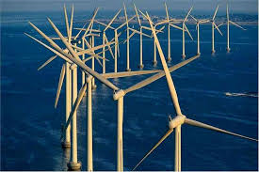
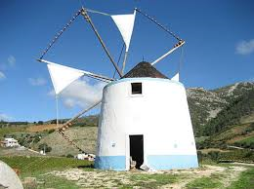
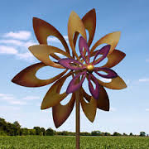
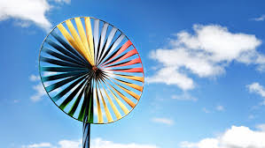

Slide 7
