Slide 1
Macro-Scale Photovoltaic Technology
An Introduction

Slide 2
Review
Quickly look over your notes from yesterday.
Turn to your elbow partner and take turns verbally describing how a photovoltaic cell works. Do your best to use the key vocabulary.
Have your partner provide feedback on your description.

Slide 3
Classroom Debrief
Quick share-out
Any lingering questions?

Slide 4
Respond to the Prompt (20 minutes)
Summarize the cycle of microscopic events which allow a solar cell to produce electricity through the photovoltaic effect.
Be sure to use all key vocabulary in your summary
Diagrams may be used to help illustrate your summary

Slide 5
Putting Photovoltaic Technology to Practical Use
Some key vocab to discuss first:
Voltage (Volts) (V)
Current (Amperes) (I)
Power (Watts) (P)
P = IV
more info: http://www.youtube.com/watch?v=ZSviOnud7uY

Slide 6
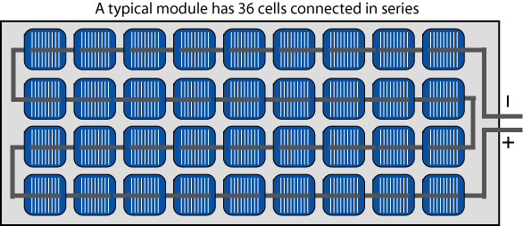
Increasing Voltage
Series Wiring:
Connecting individual cells together ( + to -) into a string
The voltage of each individual cell accumulates as they are connected in this way

Slide 7
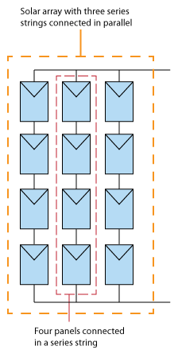
Increasing Current
Parallel Wiring
Connecting solar modules or strings together (“+ to +” and “- to-”) into parallel
The current (amperage) of each individual modules or string accumulates when wired in this way

Slide 8
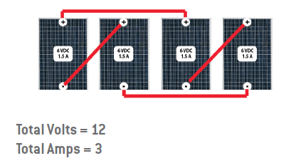
Power (Watts)
The power output is a function of both voltage and current and is calculated by multiplying the values together.
Notice that 12 volts are achieved by a series of two 6V modules
Notice that 3 amps are achieved by two 1.5A series in parallel
12V x 3A = 36 W

Slide 9
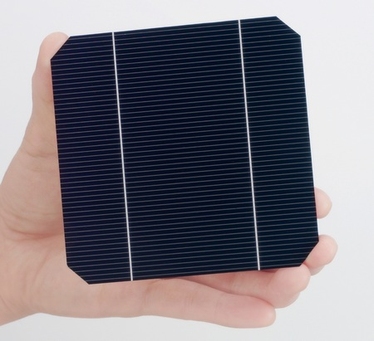
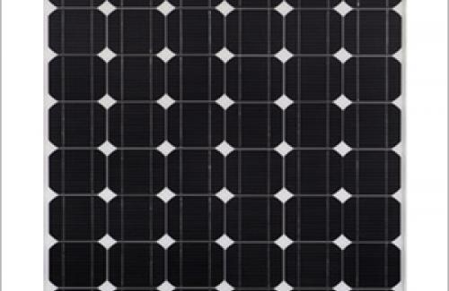
Solar Cells vs. Modules
A solar module is a photovoltaic (PV) device with multiple PV cells connected electrically (either in series or series and parallel).
The modules we will look at have a power rating of 200 Watts.
PV Cell
PV Module

Slide 10
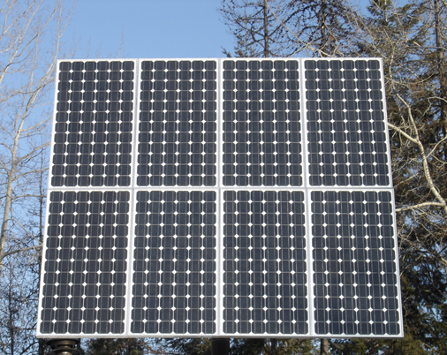
Modules vs. Arrays
A PV array consists of multiple modules connected electrically (either in series or series and parallel)
PV Array
PV Module

Slide 11
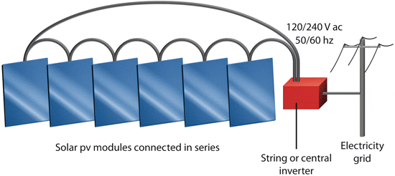
DC to AC Inverters
PV cells, modules, and arrays produce DC (direct current) electricity
In the US, the electrical grid and most household appliances are equipped to handle AC (alternating current) electricity.
(http://www.youtube.com/watch?v=xyQfrzBfnDU for more info.)
To solve this problem, inverters are installed to convert from DC to AC.

Slide 12
Review (10 minutes)
Quickly look over your notes from the past two days.
Turn to your elbow partner and take turns verbally describing how photovoltaic solar cells are wired to increase voltage and/or current.
Have your partner provide feedback on your description.

Slide 13
Classroom Debrief (5 min)
Quick share-out
Any lingering questions?

Slide 14
Respond to the Prompt (20 minutes)
Summarize how photovoltaic technology is used to produce power on the scale needed for residential and commercial purposes.
Be sure to use all key vocabulary in your summary.
Diagrams may be used to help illustrate your summary.

